Slide 1
REGEX

Slide 2
Regular Expressions(Regex) is a tool used for finding patterns within a string(text)
The regex or regexp or regular expression is written in a sequence of different characters which describe the particular search pattern. It is also referred/called as a Rational expression.
Regex is mainly used for searching and manipulating text strings.
Regular expressions are supported by many programming languages, text editors, and command-line tools, including Linux utilities like grep, sed, and awk.
They provide a powerful and flexible way to search for specific patterns, validate input, extract data, replace text, and perform various text-processing tasks.

Slide 3
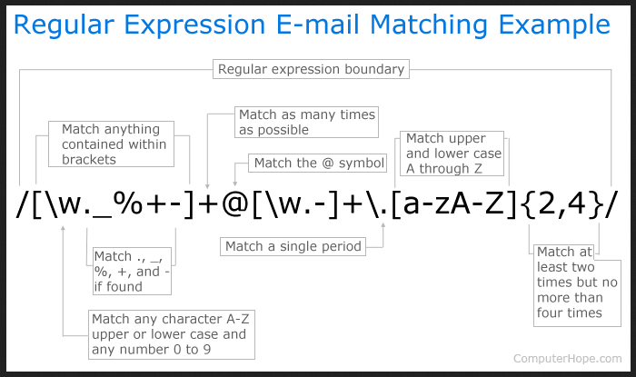

Slide 4
Regex is used in almost all the programming or scripting languages such as PHP, C, C++, Java, Perl, JavaScript, Python, Ruby, and many others.
It is also used in word processors such as word which helps users for searching the text in a document, and also used in various IDEs.
The pattern defined by the regular expression is applied to the given string or a text from left to right.
There are 4 different types of characters of a regular expression:
  Meta-characters
  Quantifier
  Groups and Ranges
  Escape Characters or character classes

Slide 5
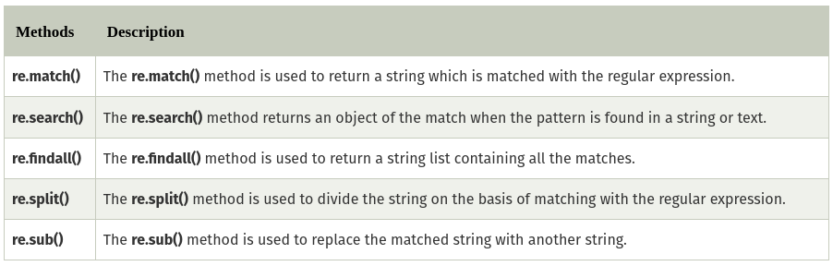
Use of Regular Expression in Python (Python Regex)
The Python programming language provides a built-in module called ‘re’ for working with regular expressions.
This module defines the various function/methods which are used for handling regular expressions
The following table defines these various functions:

Slide 6
Oniguruma
Oniguruma is a modern and flexible regular expressions library that is used across several programming languages but was originally developed for Ruby.
It encompasses features from different regular expression implementations that traditionally exist in different languages.
It has Support for a wide range of regular expression syntax:including meta-characters, quantifiers, character classes, capturing groups, assertions, and more.
It has unicode support and also a very efficient matching algorithm as well as cross platform compatibility.
Its cross platform capability serves as a powerful tool set for working with regular expressions in different programming languages.

